Slide 1
MS EcE Thesis Presentations 1st sem SY 2023 2024

Slide 2


November 03, Friday
10am to 12nn via zoom
MS EcE : Justin Roland Lee
Title:
Techno-Economic Analysis of a 144-kW Grid-Tied Photovoltaic System in the Philippines
Panel Members:
Luisito Agustin, PhD
Carlos M. Oppus, MS
Robert Alfie Pena, PhD
Thesis Adviser:
Erees Queen B. Macabebe, PhD

Slide 3
November 03, Friday
12nn to 2pm via zoom
MS EcE : Derrick L. Sze
Title:
SIMULATION OF A PICK AND PLACE SYSTEM FOR ELECTRONIC CARDS USING A YUMI COBOT
Panel Members:
Gian Paolo Mayuga, PhD
Carlos M. Oppus, MS
Jan Kevin Galicia, MS
Thesis Adviser/s:
Patricia Angela R. Abu, PhD
Rosula SJ Reyes, PhD

Slide 4
November 06, Monday
10 am to 12nn via zoom
MS EcE : Rannie Salavador
Title:
Digital Information Content Platform with Telecommunications Network-assisted Remote Monitoring and Management
Panel Members:
Carlos M. Oppus, MS
King Harold Recto, PhD
Mark Anthony Melendres, MS
Thesis Adviser:
Nathaniel Joseph C. Libatique, PhD

Slide 5
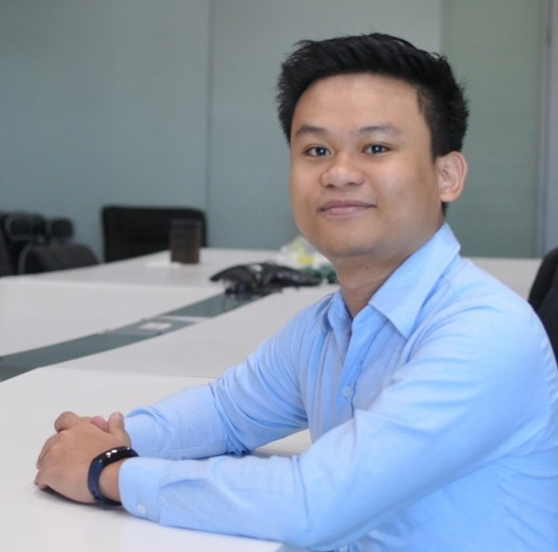
November 07, Tuesday
10 am to 12nn via zoom
MS EcE : John Donnie Celestre
Title:
Enhancing Edu-Cloud Security through Integration of SIEM
and XDR: A Cost-Effective Approach to Protecting Near-Cloud Platforms from Cyberthreats
Panel Members:
Gregory Tangonan, PhD
Carlos M. Oppus, MS
Maria Leonora Guico, MS
Thesis Adviser:
Nathaniel Joseph C. Libatique, PhD

